Slide 1
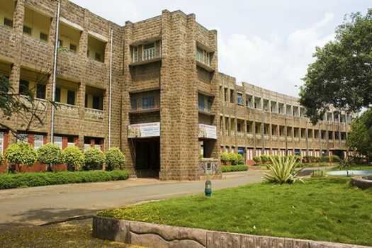
WELCOME TO NAAC PEER TEAM
Department of Humanities and Basic Sciences
Andhra University
Visakhapatnam

Slide 2
OVERVIEW
Vision & Mission
Department Profile/History/Achievement
Teaching & learning
Research, Innovation and Extensions
Curricular Aspects
Students support and Progression
Infrastructure and learning resources
Governance, leadership and Management
Institutional values and best practices
Progressive Plan

Slide 3
VISION & MISSION
VISION:
To invigorate interdisciplinary collaboration, transcend traditional boundaries, and promote the holistic development of students.
MISSION:
To be a catalyst for holistic education, shaping future engineers to be intellectually curious, socially responsible, and adaptable in a technologically evolving world.

Slide 4
QUALITY POLICY
Andhra University is Committed to achieving excellence in Teaching, Research and Consultancy:
By imparting globally focused education,
By creating world class professionals,
By establishing Synergic relationships with industry and society,
By developing state of art infrastructure and well-endowed faculty,
By imparting knowledge through teamwork and incessant efforts.

Slide 5
DEPARTMENT PROFILE (HSS)
The Department of Humanities and Basic Sciences includes six disciplines: English, Management, Economics, Soft Skills, Mathematics, and Physics.
It serves undergraduate and postgraduate students in various engineering branches.
It supports the core departments of Engineering.
It offers interdisciplinary education focusing on technical skills and societal understanding.
It emphasizes critical thinking, communication, and ethics.
Mathematics and Physics provide a strong foundation for analytical and innovative capacities.
The department is involved in research through computational modelling, theoretical physics, Management, and English studies.
Senior professors play crucial roles in academics and administration.
The department reflects Andhra University's commitment to producing well-rounded professionals.
It equips students to tackle intricate global challenges through interdisciplinary education.

Slide 6
HISTORY
Department of Humanities and Basic Sciences at Andhra University College of Engineering offers interdisciplinary education.
Physics was established in 1966, Mathematics in 1980, and Humanities and Social Sciences in 1980.
These disciplines have merged to form the Department of Humanities and Basic Sciences.
The department has contributed to projects and value additions to the College of Engineering.
Reflects Andhra University's commitment to producing well-rounded professionals.
It equips students to address intricate global challenges as an interdisciplinary education beacon.

Slide 7
Teachers List - Profile
NAME | Designation | Qualification | Experience in years | Specialization
Dr. T. Lingaraju | Professor & Chairman BOS | PhD | 31 | Fluid Mechanics
Dr. P. Vasudeva Reddy | Professor | PhD | 24 | Cryptography
Dr. Ch. Santhi Sundar Raj | Professor | PhD | 24 | Lattice theory, Fuzzy Algebra
Dr. S.K. Vali | Professor | PhD | 25 | Algebra, Lattice theory & Mathematical Modeling
Dr. Y. Ramakrishna | Professor | PhD | 24 | Nuclear Physics, Material Science, Nano Materials, Spectroscopy
Dr. A. Prasad | Professor | PhD | 31 | Marketing Management
Dr. A. Rama Naga Hanuman | Professor & Head | PhD | 18 | 20th Century American Literature, Popular Culture & English Language Teaching

Slide 8
Teachers List - Profile
NAME | Designation | Qualification | Experience in Years | Specialization
Dr. C. Balakotiah | Associate Professor | PhD | 24 | Economics
Dr. B. Swarnalatha | Associate Professor | PhD | 23 | Physics
Prof. B. Madhukar Patnaik | Adjunct Professor | Ph.D. | 32 | Economics
Prof.S.S.V.N. Sakuntala | Adjunct Professor | PhD | 32 | English
Dr. N. Sri Vidya | Assistant Professor (C) | PhD | 18 | English
Dr.A. Ramesh Babu | Assistant Professor (C) | PhD | 18 | English

Slide 9
Research, Innovations and Extensions
Teachers-Research Profile
NAME | Number of Papers published | Conferences /Training Programs Attended | H-index | Specialization
Dr. T. Lingaraju | 52 | 30 | 08 | Fluid Mechanics
Dr. P. Vasudeva Reddy | 48 | 12 | 07 | Cryptography
Dr. Ch. Santhi Sundar raj | 30 | 25 | 01 | Lattice theory, Fuzzy Algebra
Dr. S.K. Vali | 41 | 58 | 05 | Algebra, Lattice theory and Mathematical Modeling
Dr. Y. Ramakrishna | 50 | 10 | 10 | Nuclear Physics, Material Science, Nano Materials, Spectroscopy
Dr. A. Prasad | 32 | 30 | 04 | Marketing Management
Dr. A. Rama Naga Hanuman | 25 | 56 | 01 | American Literature, Popular Culture, English Language Teaching

Slide 10
Research, Innovations and Extensions (Contd.,):
Ph.D. awarded: Total PhDs awarded: 63
NAME | Number of PhDs Awarded | No of PhDs Awarded in the Assessment Period
Dr. T. Lingaraju | 11 | 05
Dr. P. Vasudeva Reddy | 07 | 04
Dr. Ch. Santhi Sundar Raj | 04 | 03
Dr. S.K. Vali | 05 | 04
Dr. A. Rama Naga Hanuman | 06 | 01
Dr. A. Prasad | 01 | 01
Dr. Y. Ramakrishna | 12 | 11
Prof. K.Chandra Mouli | 17 | 11
Prof. C.G.Rama Rao | 01 | 01
Prof. B. Indira | 09 | 05

Slide 11
Research, Innovations and Extensions (Contd.,):
Number of Research Scholars
Guide | Number of Full Time Research Scholars | Scholars with Fellowships | Number of Part Time Research Scholars
Dr. T. Lingaraju | 00 | - | 01
Dr. P. Vasudeva Reddy | 01 | - | 01
Dr. Ch. Santhi Sundar Raj | 02 | - | 03
Dr. S.K. Vali | 02 | - | 00
Dr. A. Rama Naga Hanuman | 06 | 01 | 01
Dr. A. Prasad | 03 | - | 02
Dr. Y. Ramakrishna | 02 | - | 14

Slide 12
Research, Innovations and Extensions (Contd.,):
T.Linga Raju:
1. Life member of ISTAM (Indian Society of Theoretical and Applied Mechanics, Head office IIT-Kharagpur).
2. Executive Committee member of the ISTAM society for two consecutive terms during 2006-2009 and 2010-2013.
3. Joint-Secretary of ISTAM society during 2013-2015.
4. Honorary member of the Research Board of advisers: The American Biographical Institute, USA, since 2001.
S.K.Vali:
1. Serving Andhra University as Chief Coordinator, Spot Valuations, Andhra University
2. Serving Andhra University as Nodal officer, Examination
3. Controller of Examinations at GITAM University, Visakhapatnam for 3 years
4. Head, Department of BS&HSS at JNTUK University College of Engineering, Vizianagaram for 6 years
5. I/c Head, Department of BS&HSS at PVP Siddhartha Institute of Technology Vijayawada for 4 years

Slide 13
Research, Innovations and Extensions (Contd.,):
A. Prasad:
Served as Chief Teacher for conducting 3rd year B. Tech spot valuation in 2011.
Served as Cultural Co-Ordinator for AU College of Engineering for The Intercollegiate Youth Festival twice.
Served as Teacher Associate in PGECT, ICET, EAMCET, EdCET, LAWCET, AUCET and Architecture Certificate Verification for admissions.
Served as Head, Department of Humanities and Social Sciences, AUCE from July 2014 to July 2017.
Serving as the Co-Ordinator for the Anti Ragging Squad in AU College of Engineering from March 2023 onwards.
Served as ROUT officer for the conduct of ICET examination thrice.

Slide 14
Research, Innovations and Extensions (Contd.,):
A. Rama Naga Hanuman:
Recipient of the UGC Raman Post Doctoral Fellowship Awarded by the HRD ministry under the “Indo-US 21st Century Knowledge Initiative.
Recipient of IFUSS Post Doctoral Fellowship at University of Illinois, Urbana Champagne, USA.
Recipient of OUCIP Post Doctoral Fellowship awarded by the US Consulate, Hyderabad.
Recipient of RELO Scholarship from the US Embassy, New Delhi.
Life Member, Forum on Contemporary Theory, Baroda, India.
Life Member, OUCIP (Formerly ASRC), Hyderabad.
Served as Cultural Co-Ordinator for AU College of Engineering for several years.
Currently Serving as Head, Department of Humanities and Social Sciences, AUCE.
Served as member of the Anti-Ragging Squad in AU College of Engineering.
Served as NSS Programme officer from 2010-2014 at AUCE.

Slide 15
Teaching, Learning and Evaluation
Awards; recognitions/fellowships
NAME | Designation | Award | Year of Awarding
Dr. A. Rama Naga Hanuman | Professor | UGC Raman Post Doctoral Fellowship Awarded by the HRD ministry under the “Indo-US 21st Century Knowledge Initiative” | 2014
Dr. P. Suresh Kumar (Ph. D. – 2012-17) | Research Scholar | Prof. Vallabhaneni Ramakrishna Rao Endowment Prize for the Best Ph.D. Thesis in English, Awarded by Andhra University | 2017

Slide 16
CURRICULAR ASPECTS
Courses offered
UG LEVEL B.Tech. | PG LEVEL M.Tech. | RESEARCH LEVEL M.Phil. / Ph.D.
For I Year Course Mathematics – I Mathematics – II Physics English Lab English Theory For II Year Course Mathematics – III Mathematics – IV For III Year Course Soft Skills | Probability & Statistics Mathematical Methods in Engineering. Computational Methods in Engineering Advanced Engineering. Mathematics Numerical Methods & Statistcal Analysis Advanced Engineering Mathematics & Statistics | Paper-I:Core Course Advanced Mathematical Methods In Applied Mathematics. Numerical methods, Atmospheric and Space Sciences, Solid State Physics, Ultrasonics and Its applications, Molecular Quantum Mechanics. Literary Criticism, Cultural Studies, Research Methodology, Research Writing. Paper-II: SPECIALIZATION: Fluid Dynamics Advanced Numerical Techniques Cryptography Lattice Theory Mathematical Modeling English Language Teaching, American Literature, British Literature, and Indian Writing in English

Slide 17
CURRICULAR ASPECTS
The Department of Humanities and Basic Sciences is a supporting department for all Engineering Courses at Andhra University College of Engineering
Programmes offered
Ph.D. in English, Mathematics, Physics, Management, and Economics.

Slide 18
CURRICULAR ASPECTS
OBE-framework
The Institution and Department align Vision, Mission, and Educational Objectives with societal needs.
Accredited by the National Board, Andhra University implements Outcome-Based Education (OBE) since 2015.
OBE ensures students are well-prepared with skills and knowledge and promotes continuous improvement through assessments, rubrics, and faculty development.
Correlations between Course and Program Outcomes are established, aiming for excellence in multidisciplinary education, employability, ethics, and global competitiveness.
OBE fosters pedagogically designed objectives to enhance learning outcomes for diverse needs.
Andhra University strives for academic excellence through faculty and student initiatives.
They preserve national and international standards and promote understanding among stakeholders.

Slide 19
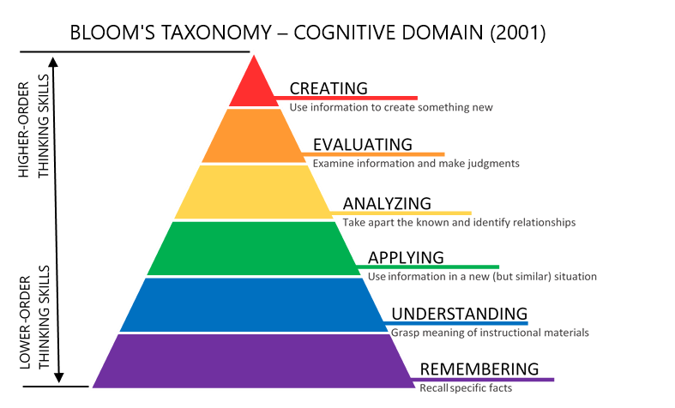
CURRICULAR ASPECTS
OBE-framework
Syllabus is designed as per the Blooms Taxonomy Framework

Slide 20
CURRICULAR ASPECTS
POs
Program Outcomes (POs) are essential for academic excellence.
They align with institutional and societal goals and reflect a graduate's capabilities.
Outcome-Based Education (OBE) ensures students acquire essential skills, knowledge, and values.
POs drive curriculum design, assessment, and continuous improvement.
They guarantee undergraduates possess competence, adaptability, and ethical grounding as they enter professional realms.
Universities worldwide integrate POs to foster holistic growth and meet evolving global demands.
POs signify a commitment to producing well-rounded, impactful professionals.

Slide 21
CURRICULAR ASPECTS (CONTD.,)
Integration of Environmental Sustainability Human values in the Curriculum
The curriculum integrates environmental sustainability and human values through English and soft skills, while also exploring their implications in management and economics, nurturing responsible global citizens.
Courses with employability/Skill development/value added programmes offered
English
Soft Skills
Entrepreneurship
Engineering Maths
Engineering Physics
Managerial Economics

Slide 22
CURRICULAR ASPECTS (CONTD.,)
Feedback for curriculum
Feedback collected and analysed for curriculum integration of English and soft skills.
Aim is to align with students’ needs and enhance holistic learning.
Feedback gathered through surveys and interactive sessions to gauge student perspectives.
Thorough analysis identifies strengths and areas for improvement.
Helps in curriculum enhancement and better integration of English and soft skills.

Slide 23
Teaching, Learning and Evaluation (CONTD.,)
Student categorisations (Advanced learners/slow learners)
Comprehension and IQ levels determine categorization as slow or advanced learners.
Comprehensive assessments, including tests and evaluations, identify individual strengths and areas for improvement.
Categorization enables tailored teaching approaches.
These approaches ensure unique learning needs are met effectively.
They promote inclusive education.
Programmes for Advanced Learners
Specialized programs in the department for advanced learners:
Accelerated coursework
Research projects
Advanced seminars
These programs offer intellectual challenges and in-depth exploration.
They cultivate a culture of academic excellence.
Aim to help advanced students excel and realize their full potential.

Slide 24
Teaching, Learning and Evaluation (CONTD.,)
Programmes for Slow Learners
Specialized programs for slow learners
Tailored to individual needs
Includes personalized tutoring
Additional practice sessions
Mentorship programs
Ensures support for academic success and thriving
Methods of teaching
Diverse teaching methods employed.
Blackboard
ICT
Online
Technical subjects: lectures and hands-on lab sessions for practical knowledge.
Humanities and social sciences: interactive discussions and case studies.
Promotes critical thinking and well-rounded development.

Slide 25
Research, Innovations and Extensions (Contd.,):
Number of JRF/SRF/PDF/RA
Research Scholars under RGNF scheme |  | Awarded Amount Per Month
1. M. Shanthi (Mathematics)
JRF | 03-04-2014 TO 02-04-2016 | ₹30,000 (including HRA)
SRF | 03-04-2016 TO 19-03-2018 | ₹36,000 (including HRA)
2. S. Nageswara Rao (Mathematics)
JRF | 24-01-2016 TO 23-01-2018 | ₹30,000 (including HRA)
SRF | 24-01-2018 TO 24-01-2021 | ₹36,000 (including HRA)
3. P. Anantha Rao (Physics)
JRF | 01-02-2016 TO 31-01-2018 | ₹30,000 (including HRA)
SRF | 01-02-2018 TO 31-01-2021 | ₹36,000 (including HRA)
3. Pratap Challa (English)
JRF | From 02-02-2022 | ₹36,000 (including HRA)

Slide 26
Theses Uploaded on Sodhganga
Research, Innovations and Extensions (Contd.,):
Subject | No of Thesis Uploaded | Sodhganga Link
English | 20 | https://shodhganga.inflibnet.ac.in/handle/10603/28731
Management | 01 | https://shodhganga.inflibnet.ac.in/jspui/handle/10603/8644
Engineering Physics | 20 | https://shodhganga.inflibnet.ac.in/handle/10603/364032
Engineering Mathematics | 17 | https://shodhganga.inflibnet.ac.in/handle/10603/375679

Slide 27
Research, Innovations and Extensions (Contd.,):
Code of ethics
Department upholds a rigorous code of ethics.
Fosters a culture of integrity, respect, and responsibility.
Students and faculty adhere to ethical guidelines.
Promotes honesty, fairness, and academic excellence.
Cultivates a supportive and ethical learning environment.
Prepares individuals for ethical challenges in their future endeavours.

Slide 28
Infrastructure and teaching resources:
Physical facilities
Each staff member is provided with a Personal Computer with Internet connection.
Computers – 07
Printer/Scanner cum Xerox – 04
Printer - 03
LCD Projector - 02

Slide 29
Institution values and Social responsibilities:
Gender Sensitization
Gender sensitization integral to the department’s ethos.
Aligned with institutional values and social responsibilities.
Achieved through workshops, inclusive policies, and awareness campaigns.
Disha App drive has happened initiating its use by all girl students.
She Team awareness programs are conducted.
Fosters an environment promoting gender equality.
Empowers all individuals and contributes to a diverse and inclusive academic community.

Slide 30
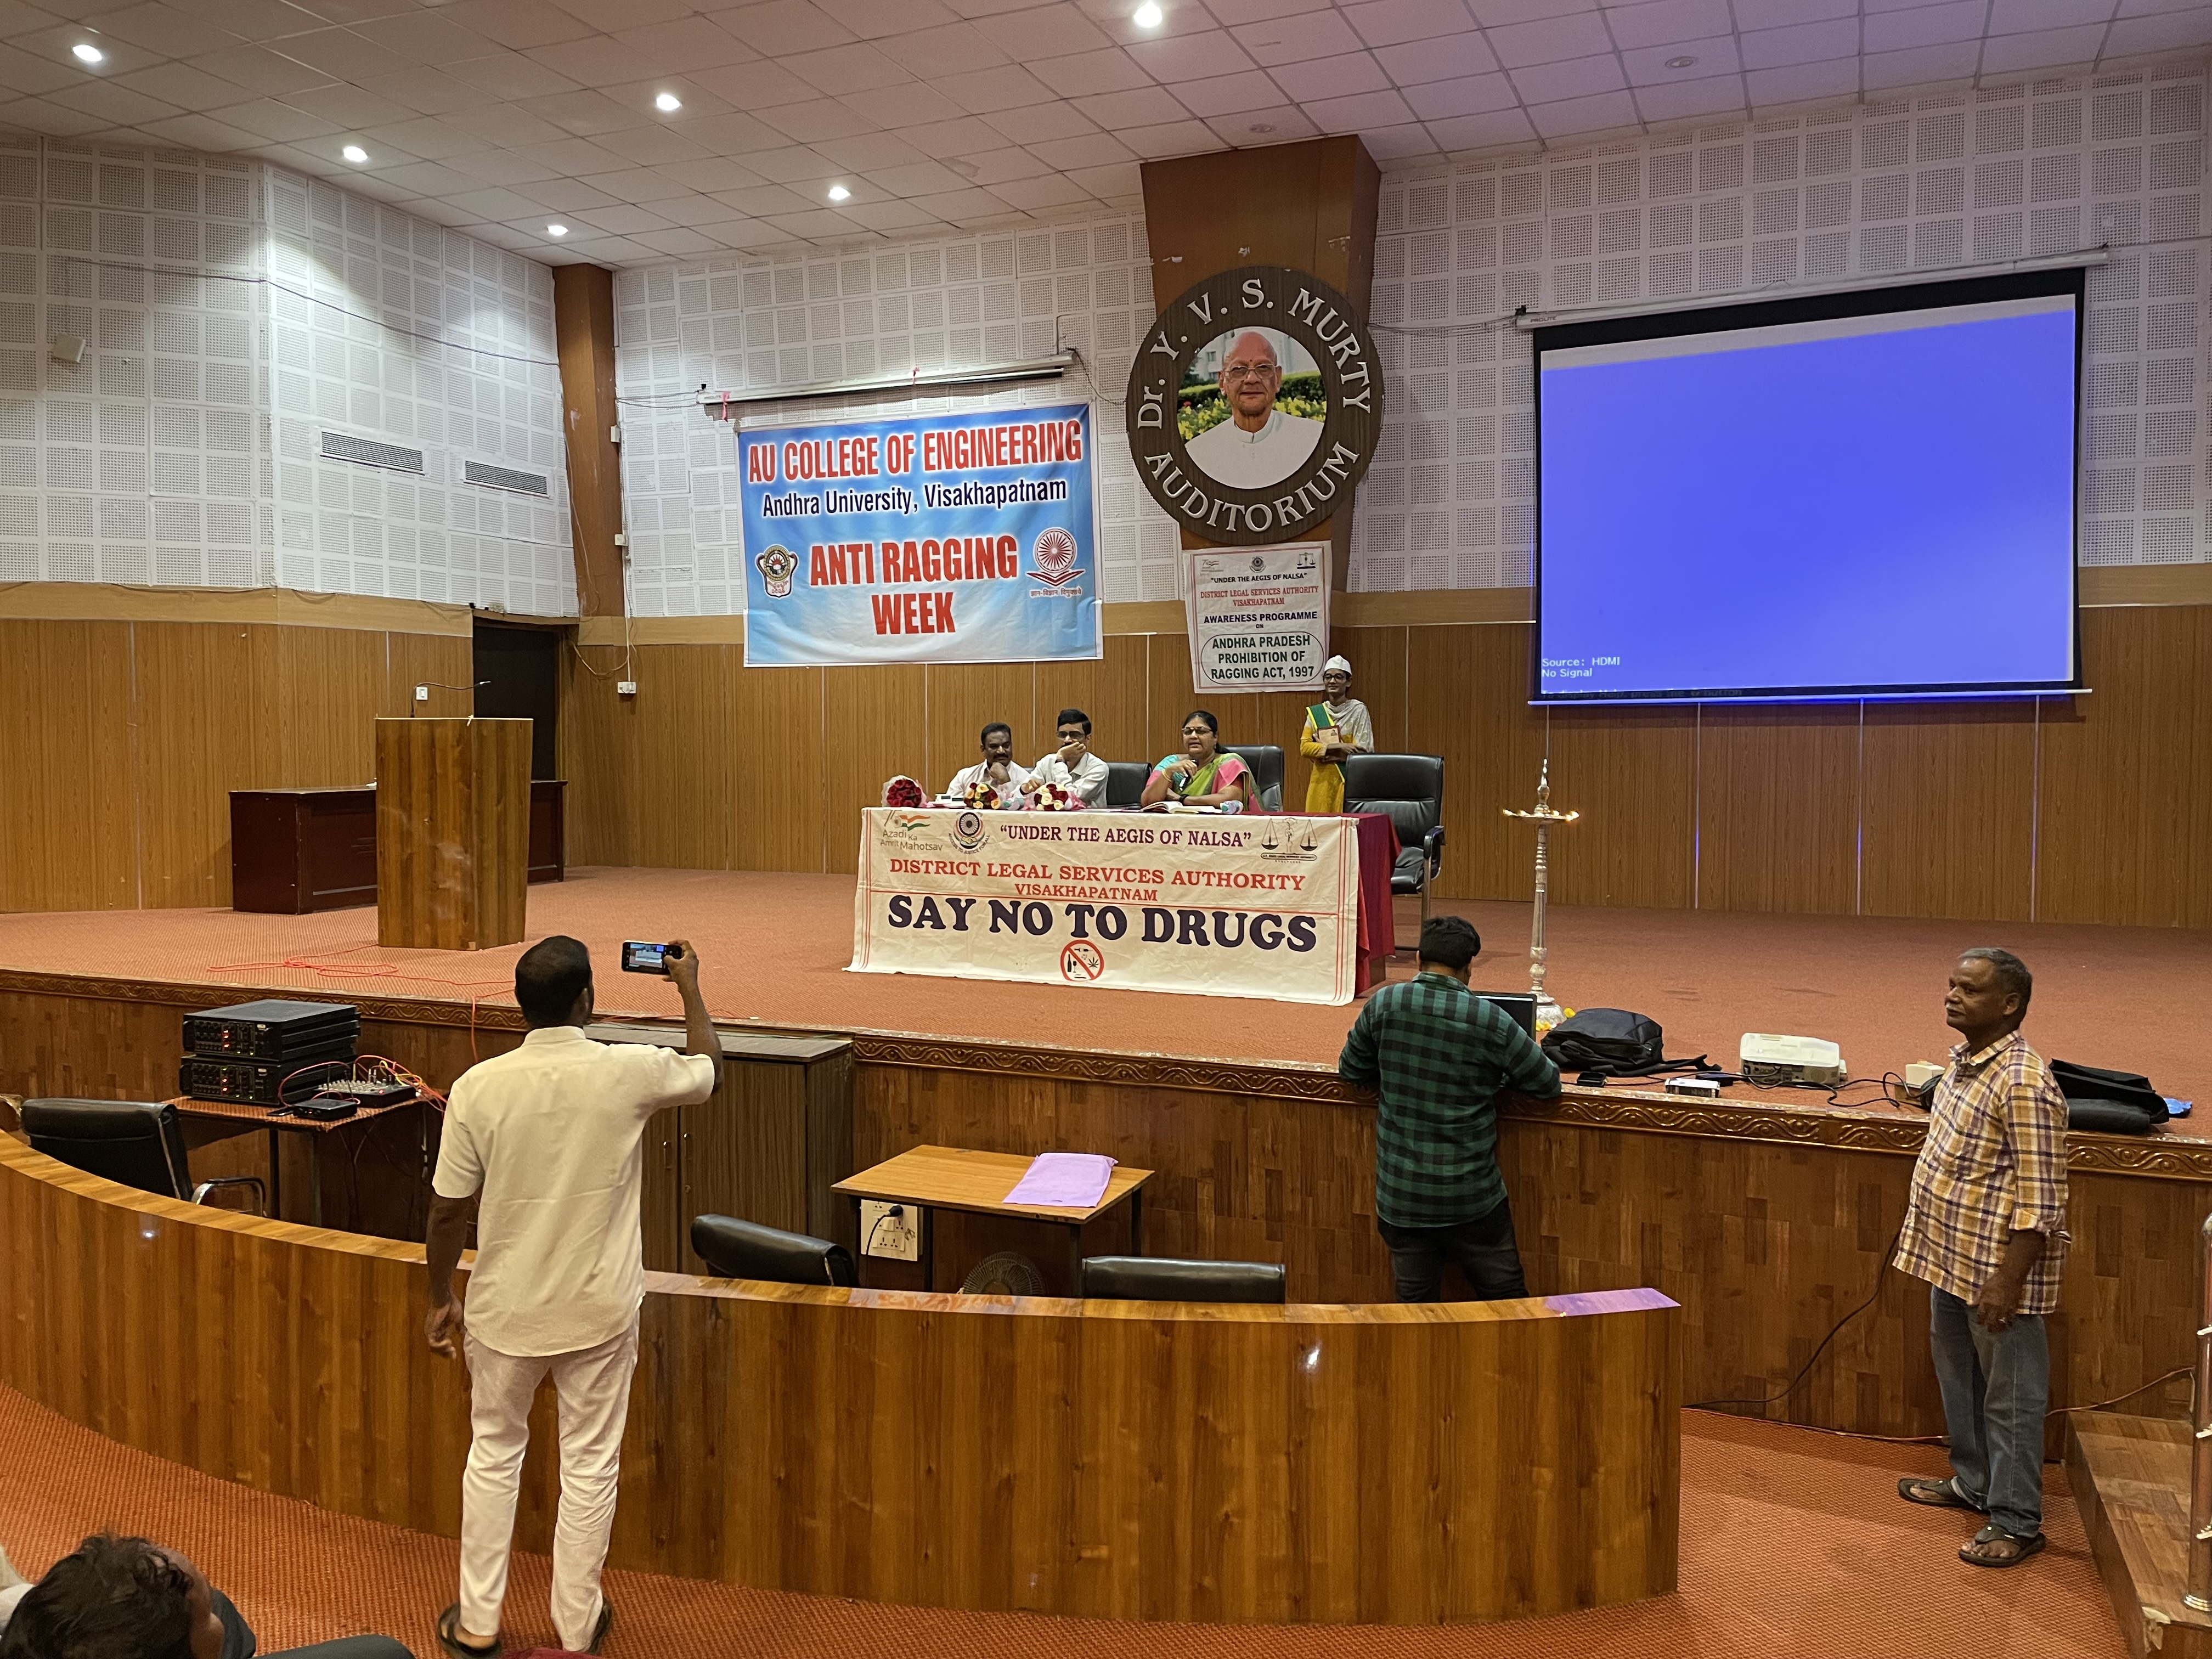
Institution values and Social responsibilities:
Anti ragging
Prof. A. Prasad serves as the Co-Ordinator of the Anti-Ragging Squad at the College of Engineering.
He collaborates with Anti-Ragging Student mentors.
Organizes awareness programs.
Provides immediate response and support for ragging prevention on campus.

Slide 31
Progressive Plan
Future Plans:
To apply and work on major research projects.
Scholars should be encouraged to publish in Scopus Indexed and UGC Care listed Journals.
To attend more FDPs according to the area of specialization.
To conduct Conferences / Seminars / Workshops at regular intervals uplifting the face of the department.

Slide 32
Thank you!

